Slide 1
Comparing Apples and Oranges
Getting Back in Control

Slide 2
You know What’s Coming
🙌
KAHOOT

Slide 3
Try noW!
🍌
Ask the user how many bananas they want
5 or less bananas cost 50 cents each, 5 to 10 cost 35 cents each, 10 or more cost 25 cents each
Output how much the customer’s order will cost
Make a program that outputs the price of bananas.

Slide 4
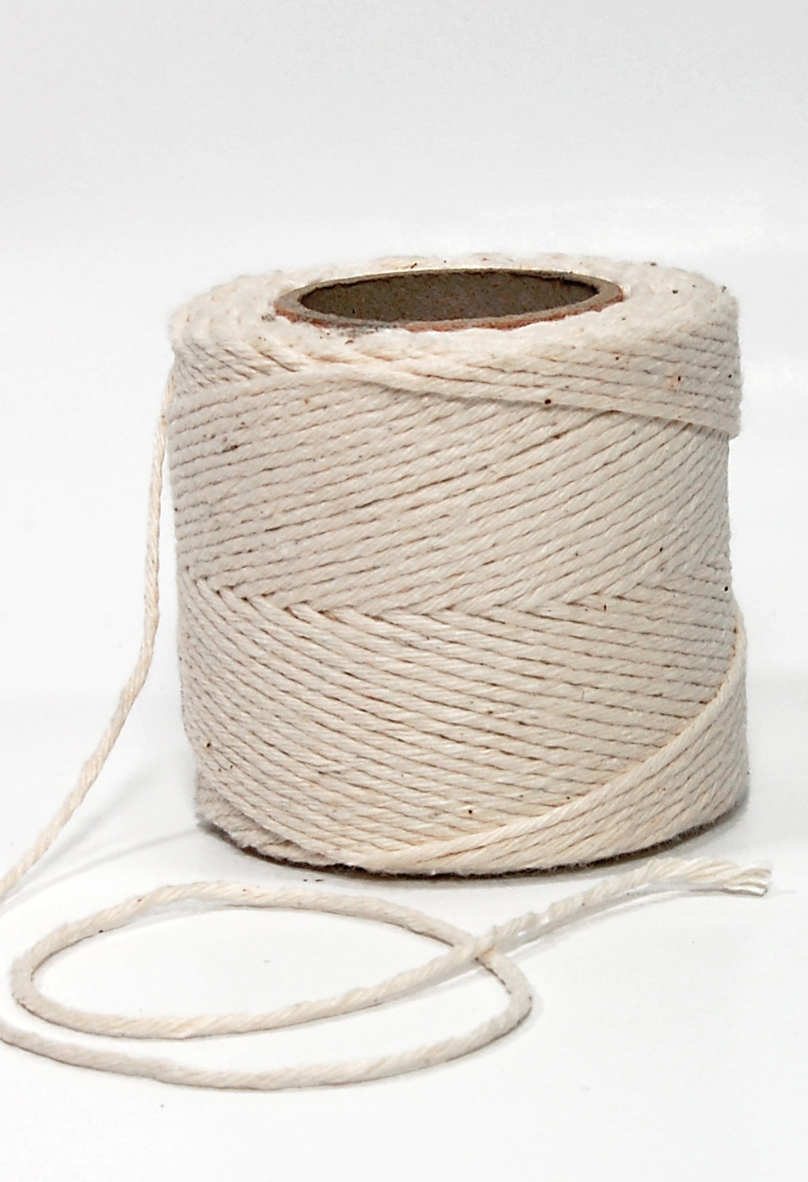
Strings Are Hard...
What if you want to get the type of fruit the user wants?
Apple, banana, pineapple
How do you represent apple vs. banana?

Slide 5
Remember That Strings are Complex
A String is actually a bunch of char(acters) concatenated together
So to compare Strings, you actually need to compare each character inside

Slide 6
Comparing Apples and Oranges
A
P
P
L
E
S
O
R
A
N
G
E
S

Slide 7
Comparing Apples and Oranges
Lucky for us, Java gives us a way to do this quickly and easily
String name = “Andrew”;
if ( name.equals(“Andrew”) ){
System.out.println(“You’re a cool guy!”);
}

Slide 8
Booleans and Logical Operators
Two things that you’ll find very useful are logical operators
If I want to check if two different conditions are true, I use and
If I want to check if either one condition or another are true, use or
&& - and
|| - or

Slide 9
How do I check if an integer is greater than 10 and less than 50?
int number = 35;
if ((number > 10) && (number < 50)) {
System.out.println(“It is between 10 and 50!”);
}

Slide 10
How do I check if a String is “Andrew” or “Ryan”?
String name = “Andrew”;
if ((name.equals(“Andrew”)) || (name.equals(“Ryan”)) {
System.out.println(“You must be cool!”);
}

Slide 11
Comparing apples and Bananas
Banana Prices… Now with Apples!
🍌 🍎 🍏
Make a program that outputs the price of bananas and the price of apples

Slide 12
Ask the user if they want apples or bananas
Ask how many of that fruit they want
Apples cost
15 cents for orders less than 10
10 cents for orders between 10 - 20 (inclusive)
5 cents for any more than 20
Bananas cost
50 cents each for orders less than 5
35 cents for orders 5 - 10 (inclusive)
25 cents for orders more than 10
Print the total cost (in cents) and the type of the fruit

Slide 13
Booleans Expressions
if ( what goes here? ){
// do something
}
An expression that evaluates to true or false

Slide 14
Booleans and Relational operators
So how do you make an expression?
You compare things!
How do you compare things?
Relational operators...
<
>
<=
>=
==
!=

